Slide 1
Country engagement spectrums

Slide 2
Smart Network
consultation
partnership
locally led
locally owned
Programs and initiatives are reviewed to ensure greater inclusion and influence of local and national actors.
Locally defined and leading to further locally led humanitarian action; equitable and complimentary, leveraging diverse capabilities.
Local actors are resourced to directly access and manage necessary expertise and technical skills.
Local and national actors hold the power on decisions which affect them.
Source: https://startnetwork.org/

Slide 3
CH Task Force
engage
partner with
country led
country owned
Have a dialogue with local partners around trainings or other local activities
Develop local activities together with local partners
Work with local partners in activities that they develop and where they suggest external help would be useful
The CH Task Force supports local partners in efforts they initiate and sustain
support & facilitate together with used throughout the spectrum
Notes:
Questions:
At what point is the Task Force ‘invited’ to the country led or owned process?
Who initiates the working together?

Slide 4
LEAF Assessment: Oxfam and Save the Children
informing
consultation
partnership
delegated power
Local stakeholders receive information regarding a project phase and may share their views, but without any effort by the donor/implementing partner to consider or act on these views.
Local stakeholders share their views on a project phase with the donor/implementing partner obligated in some way to consider or act on these views and to communicate how this input impacted the project.
Local stakeholders are part of a formal system that provides them an opportunity to work with the donor/implementing partner to make decisions jointly for a project phase.
Local stakeholders take the lead in making decisions and taking action with regard to a project phase within agreed parameters.
Source: https://www.powerofownership.org/

Slide 5
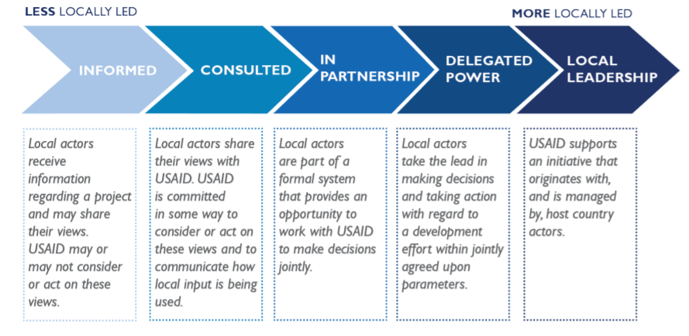
Locally Led Development: USAID
Source: https://www.usaid.gov/sites/default/files/documents/What_is_Locally_Led_Development_Fact_Sheet.pdf

Slide 6
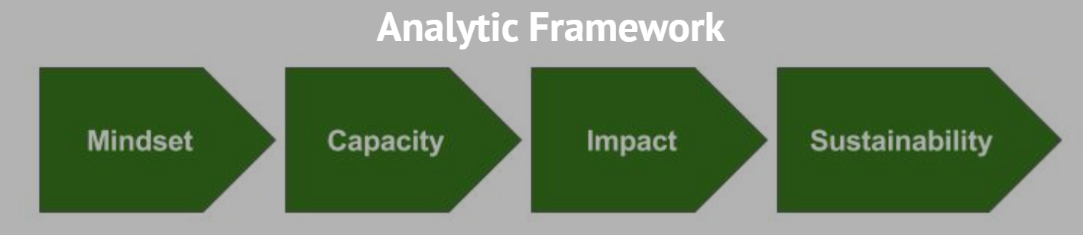
Movement for Community Led Development
Note: Both the Smart Network and Movement for Community Led Development include Task Force members such as Save the Children and Care.
Source: https://mcld.org/analytic-framework/

